Slide 1



NEW KX SERIES
WHERE SMOOTHNESS MEETS PERFORMANCE

Slide 2
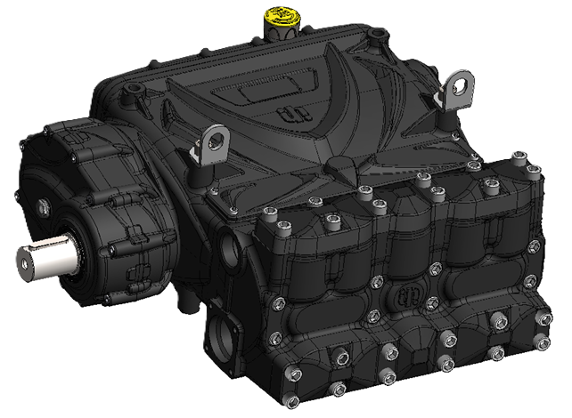
NEW KX SERIES
120 HP FIVE PLUNGER PUMP
QUINTUPLEX
TECHNOLOGY
SMOOTHER FLOW
IMPROVED JETTING PERFORMANCE
LOWER SYSTEM STRESS
INCREASED DURABILITY
REDUCED VIBRATION
HIGHER OPERATIONAL EFFICIENCY
OPERATING PRESSURE up to 240 Bar
FLOW RATE up to 344 l/min
POWER RATING up to 120 HP

Slide 3
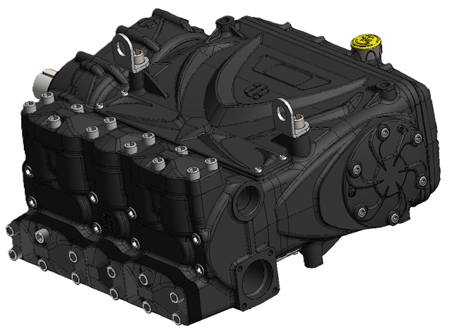
NEW KX SERIES
PERFORMANCE CHART
MODEL | GEAR BOX VERSION | RPM | GEAR RATIO | FLOW |  | PRESSURE |  | POWER
 |  |  |  | l/min | GPM | bar | psi | kW | Hp
KX 30 | NO | 1095 | - | 194 | 51 | 240 | 3480 | 89 | 121
 | YES | 1500 | 1,37
 |  | 1800 | 1,667
 |  | 2200 | 2,048
KX 32 | NO | 1095 | - | 220 | 58 | 210 | 3045 | 88 | 120
 | YES | 1500 | 1,37
 |  | 1800 | 1,667
 |  | 2200 | 2,048
KX 36 | NO | 1095 | - | 279 | 74 | 170 | 2465 | 90 | 123
 | YES | 1500 | 1,37
 |  | 1800 | 1,667
 |  | 2200 | 2,048
KX 40 | NO | 1095 | - | 344 | 91 | 140 | 2030 | 92 | 125
 | YES | 1500 | 1,37
 |  | 1800 | 1,667
 |  | 2200 | 2,048

Slide 4
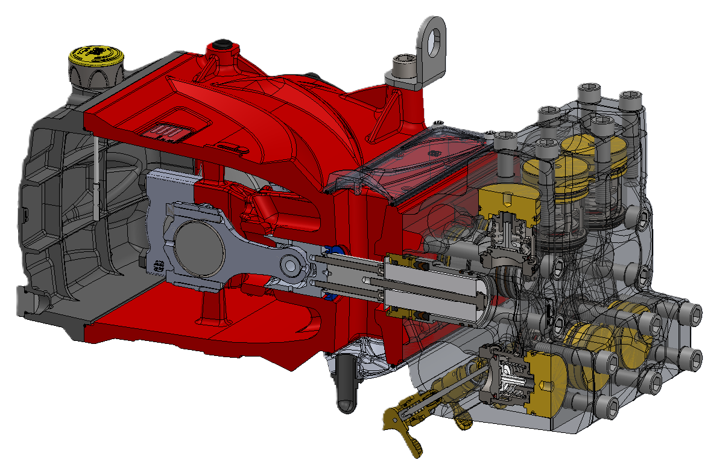
NEW KX SERIES
FEATURES AND BENEFITS
LIGHTWEIGHT AND EFFICIENT
WEIGHING JUST 168kg, THIS INNOVATIVE QUINTUPLEX DESIGN BOASTS 120HP WHILE OFFERING A MINIMUM 40% WEIGHT REDUCTION AS COMPARED TO OTHER STANDARD 100HP POWER FRAMES.

Slide 5
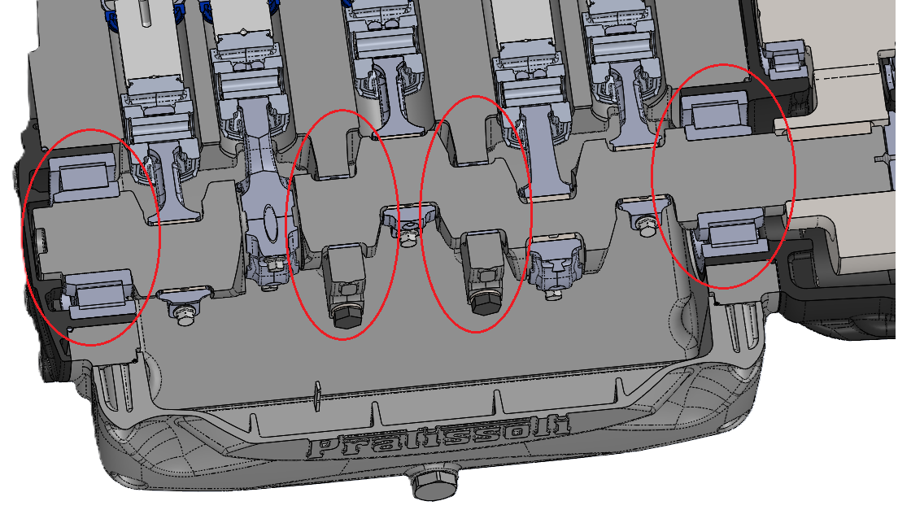
NEW KX SERIES
FEATURES AND BENEFITS
MAXIMUM RELIABILITY
THE NEW CRANKSHAFT IS DESIGNED USING TODAY’S MODERN STANDARDS WHILE BEING STRONGLY SUPPORTED BY A SERIES OF INDUSTRIAL ROLLER BEARINGS AND JOURNALS.

Slide 6
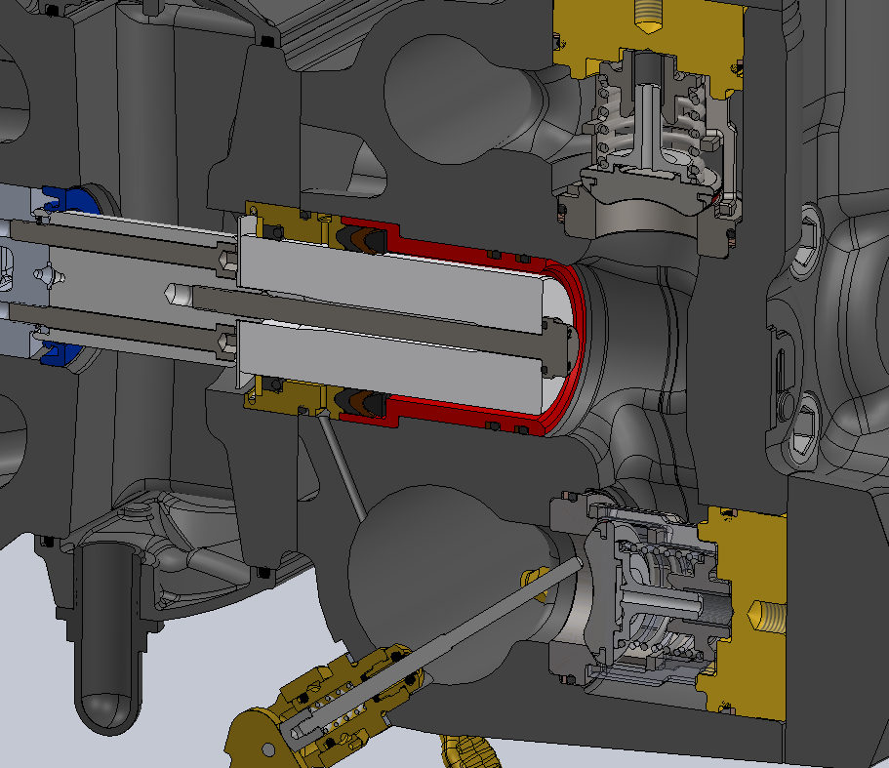
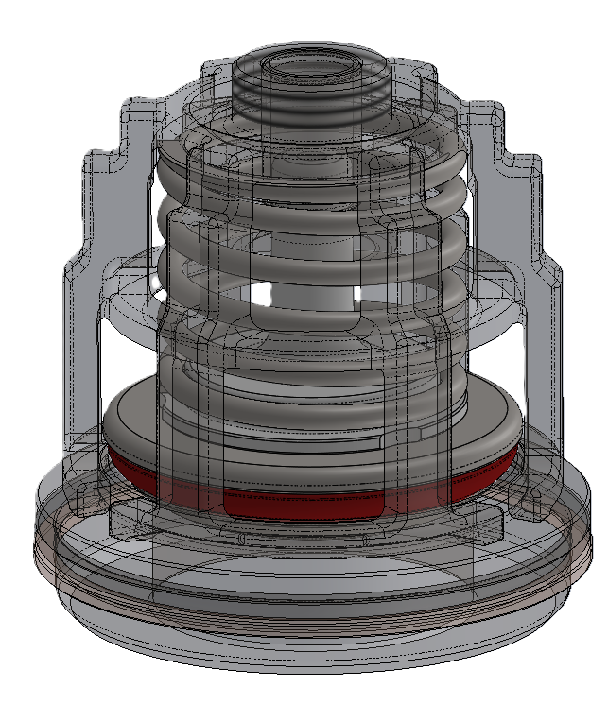
NEW KX SERIES
FEATURES AND BENEFITS
DURABILITY IN ADVERSE CONDITIONS
THE CAST IRON HEAD FEATURES OUR PROPRIETARY HR TREATMENT FOR INCREASED CORROSION RESISTANCE WHILE THE STEEL CYLINDERS AND SOLID CERAMIC PLUNGERS ARE THE FOUNDATION FOR A SUPERIOR FLUID END DESIGN.
SUCTION AND DELIVERY VALVES WITH SPHERICAL CONTACT AND GUIDE SYSTEM ARE EQUIPPED WITH
ANTI-ABRASION RING WHICH EXTENDS THEIR LIFE AND REDUCES THE PUMP’S OPERATING NOISE.

Slide 7
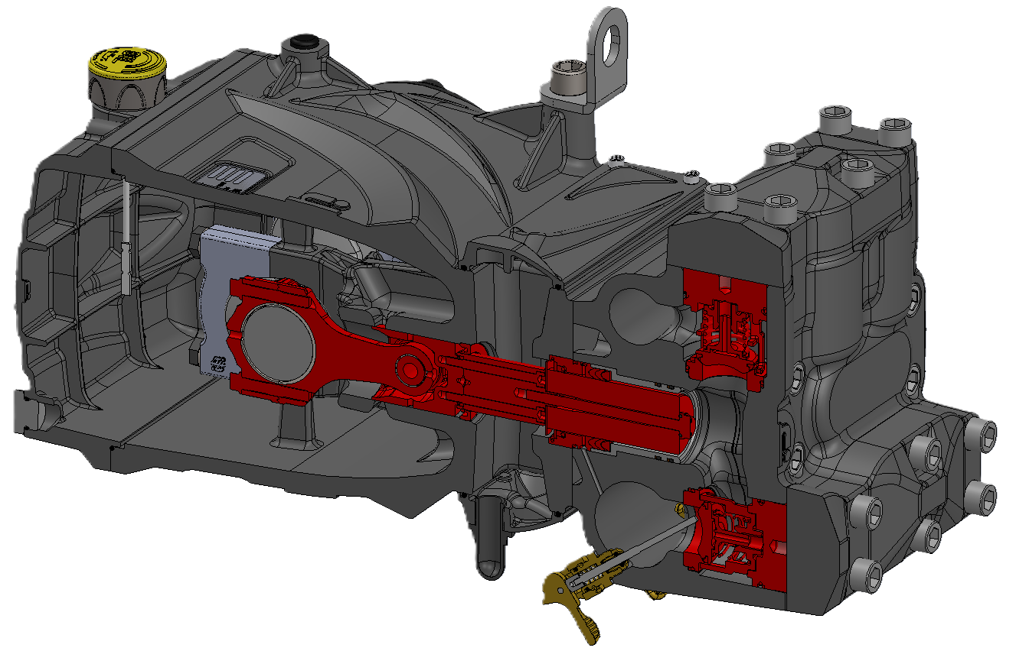
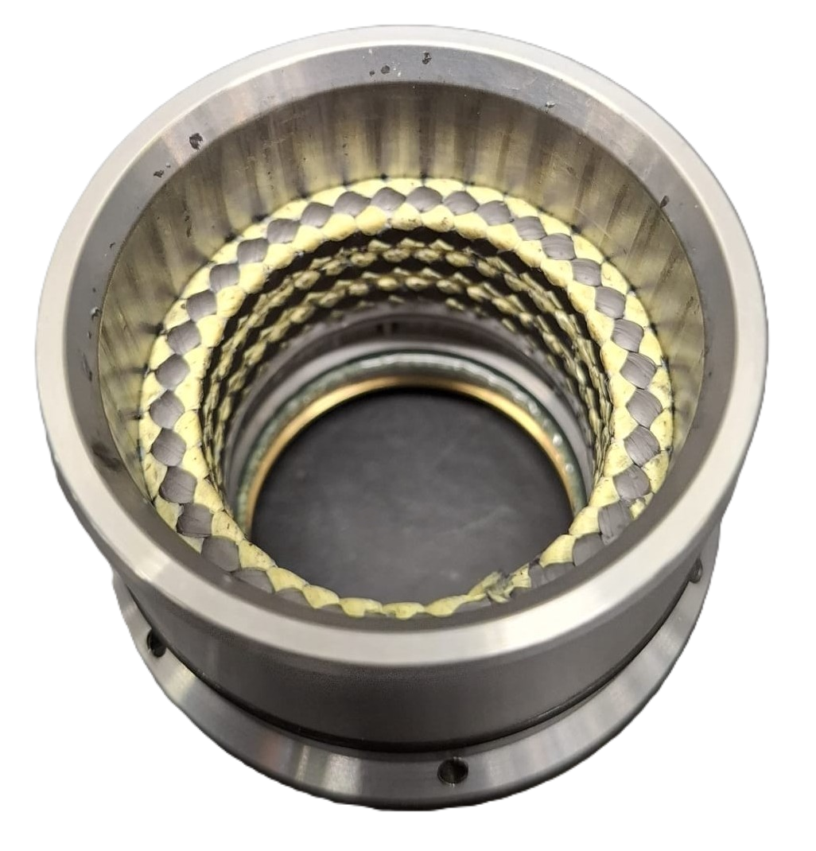
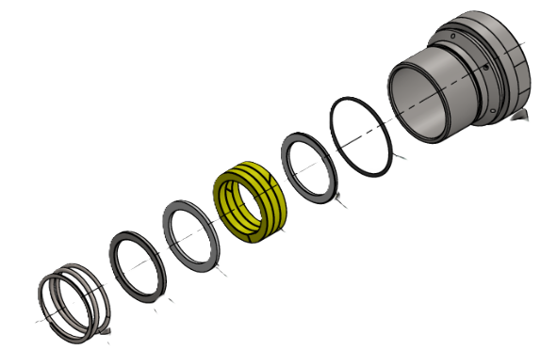
NEW KX SERIES
FEATURES AND BENEFITS
EASE OF MAINTANENCE
PRIMARY COMPONENTS AND WEAR PARTS ARE SHARED WITH OUR OTHER PROVEN DESIGNS (KF/KS SERIES) TO ENSURE FAMILIARITY AND CONSISTENT SUPPLY OF RAPLACEMENT PARTS. THE INTERGRATED PRIMING/DRAIN VALVES ALLOW FOR QUICK PRIMING AND WINTERIZATION. RUN DRY “R” SEALS OPTION AVAILABLE*.
*RUN DRY SEALS OPTIONAL
85°C WATER TEMPERATURE
KEVLAR/TEFLON material
STUFFING BOX SEALS
200 mic. SOLID PARTICLES ALLOWED

Slide 8
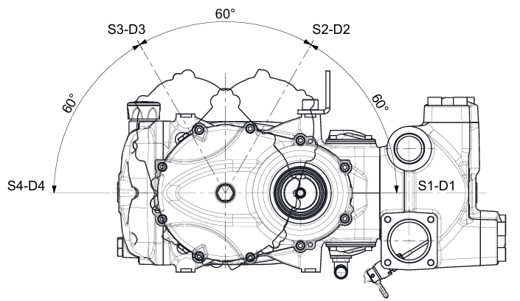
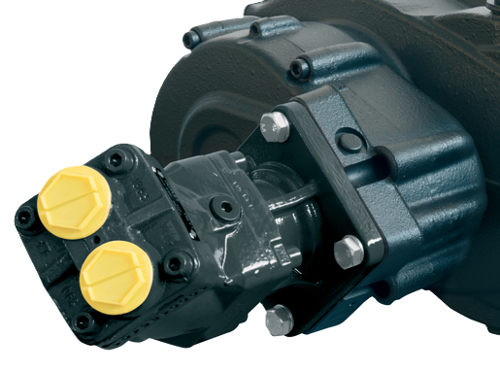
NEW KX SERIES
FEATURES AND BENEFITS
VERSATILITY/EASY INSTALLATION
THE SIMMETRICAL CRANKCASE ALLOWS FOR EASY LEFT TO RIGHT CONVERSION WITH AN OPTIONAL 3 RATIO GEARBOX THAT CAN BE MOUNTED IN FOUR DIFFERENT POSITIONS.
HYDRAULIC DRIVE OPTIONS WILL BE AVAILABLE SOON.

Slide 9
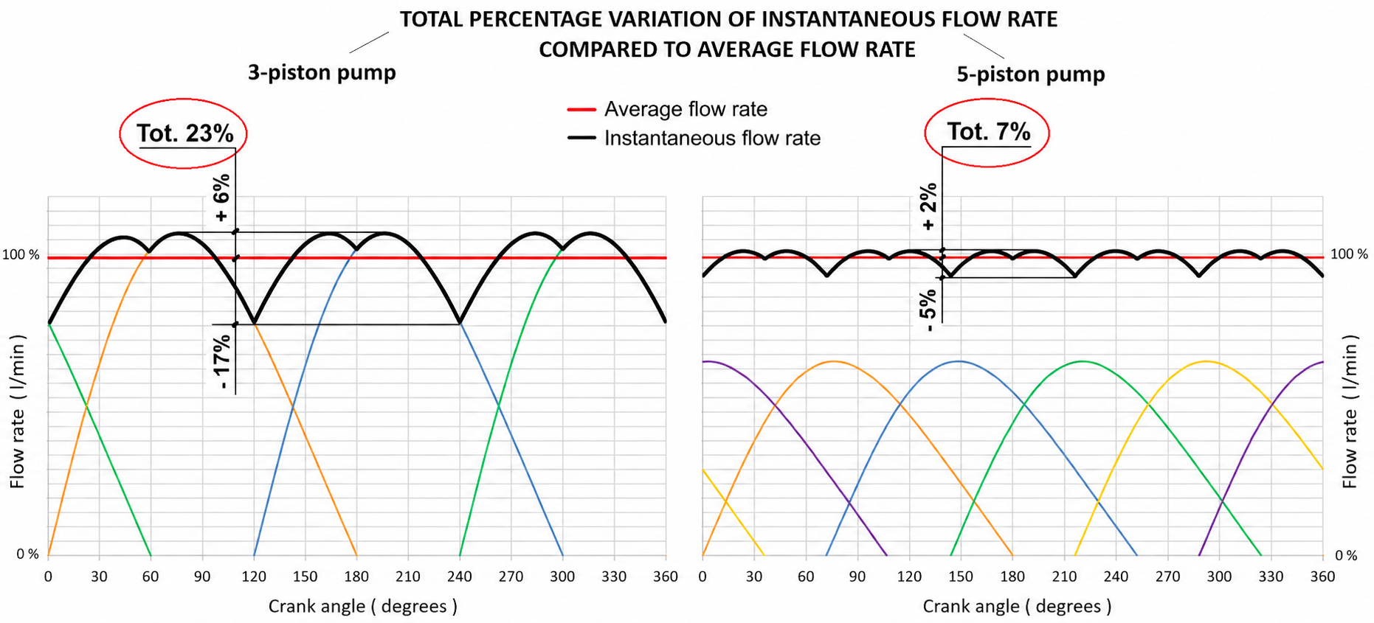
NEW KX SERIES
FEATURES AND BENEFITS
SMOOTH OPERATION
COMPARED TO THE MORE COMMONLY USED THREE-PISTON CONFIGURATION, THE LEVEL OF PULSATION IS SIGNIFICANTLY LOWER.

Slide 10
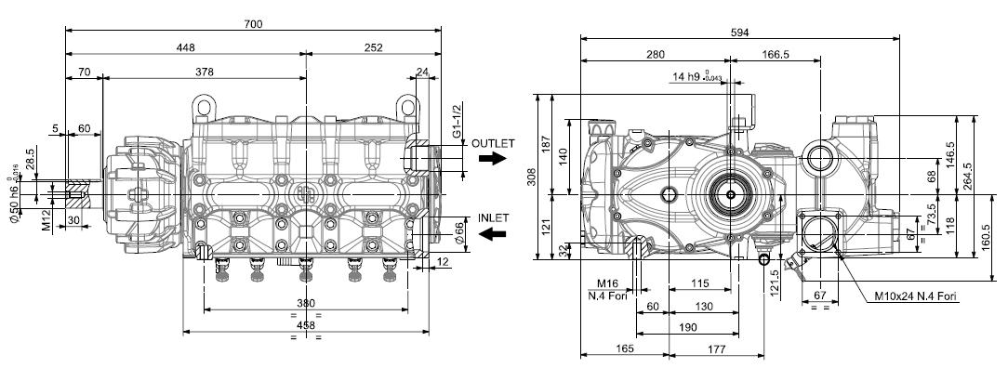
NEW KX SERIES
OVERALL DIMENSIONS

Slide 11
NEW KX SERIES
THE FUTURE OF SEWER JETTING STARTS NOW!!
GET IN TOUCH WITH OUR SALES TEAM INFO@INTERPUMPGROUP.IT

Slide 12
WWW.PRATISSOLIPOMPE.IT

